Slide 1
Brain Tumor MRI Classification and Localization
University of Information Technology (UIT) – VNU HCMC
AI – CS106
Quan Hoang Ngoc - 22521178
Cam-Giang Tran-Thi - 22520361
Professor: PhD. Hoang Luong Ngoc
6/2024

Slide 2
01
Introduction
02
Problem Statement
Methodology and Breakout
03
Table of
Contents
Multi Case-Study
04
Result Experiment
05
Conclusion
06
07
Discussion

Slide 3
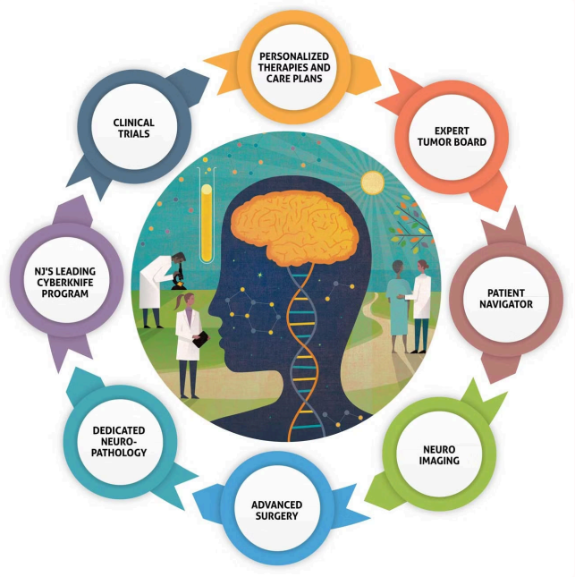
Table of Contents

Slide 4
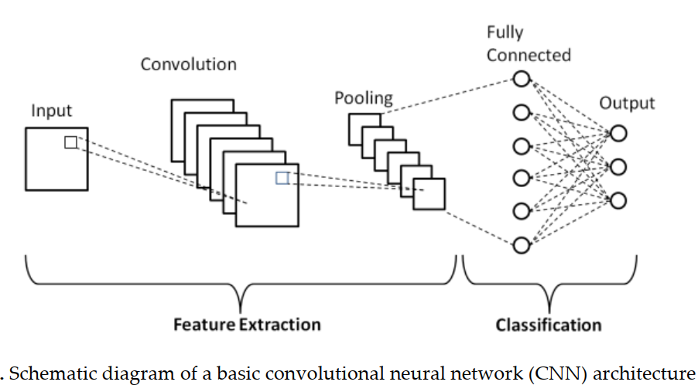

Introduction
Why it matters?
Brain tumor classification and localization: is a crucial task in medical imaging for accurate diagnosis and treatment planning.
CNNs model are very robust to address with large amounts of training data.
But, more and more scarcity of medical data. How to deal these challenges?

Slide 5
Problem
Input:
Output:
Inference: a brain MRI image, which be a 2D slice.
Training: a shortage dataset consists of labeled images with the corresponding annotation for each image.
The output of the model is a predicted label (yes or no tumor).
Besides, we also provide the predicted location of the tumor center, as an evidence for the model's decision.
Constraint: this is a few short learning problem.
Notes:
, which can be probability scores indicating the likelihood of belonging to a specific tumor class.

Slide 6
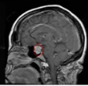
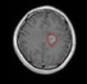
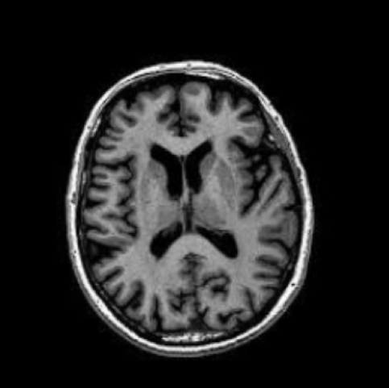
Problem
Inference illustration
Yes
(63, 50)
Yes
(50, 65)
No

Slide 7
Contribution
The aim of research project
The aim of this research project is to develop methods can accurately classify and provide evidence of the center of the tumor that dealing good with scarcity of data.
Besides, we also perform a comprehensive comparison of various strategies and evaluate their effectiveness on shortage data benchmarks. Then, we try to explain these results.
Finally, we find out some novel insights and directions in Reinforcement Learning.

Slide 8
Methodology
History of project
In all this project,
We have come up with and applied a variety of strategies and techniques, including Machine Learning, Computer Vision, Reinforcement Learning, and combine them.
However, within the limitation of time, we can only focus on breakthrough solutions and present the highlights of the project.

Slide 9

The breakthrough
Reinforcement Learning
Hypothesis: It is our conviction that Reinforcement Learning (RL) will exhibit similarities to human learning by leveraging a minimal amount of information to generalize across differences. Through a process of insight search, exploration and exploitation of the training dataset, RL can efficiently navigate limited data spaces.

Slide 10
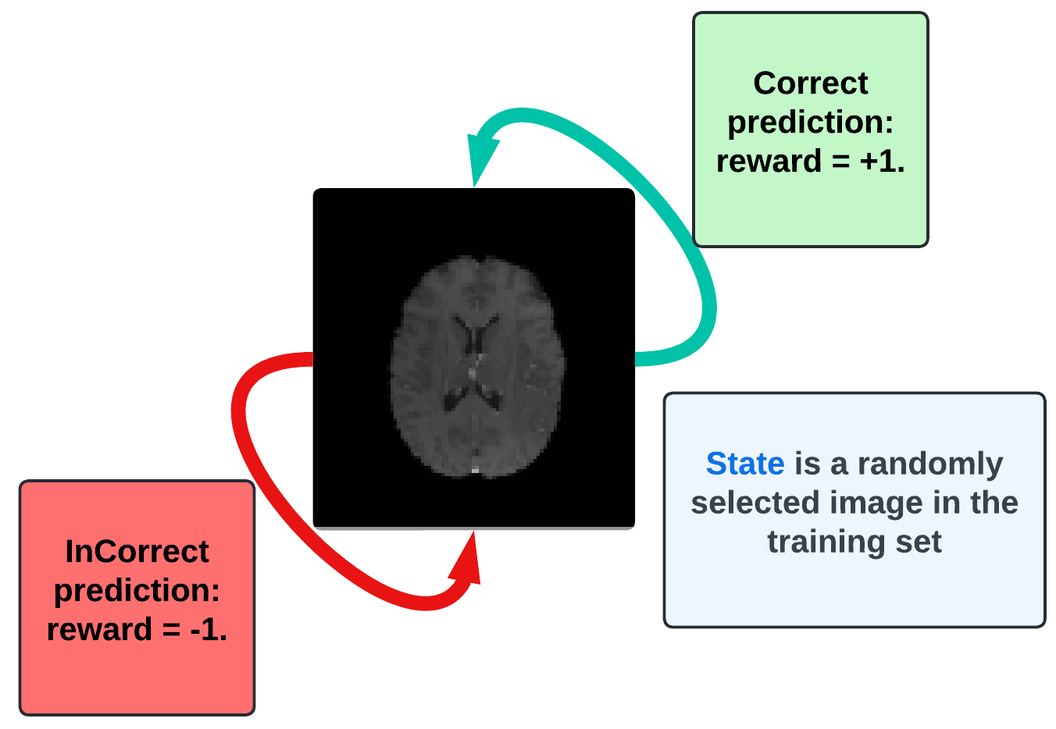
Classification
How to define a MDP
Action: An agent's action is a label prediction for the image which is a state of the environment, where 0 corresponds to no, and 1 corresponds to yes.

Slide 11
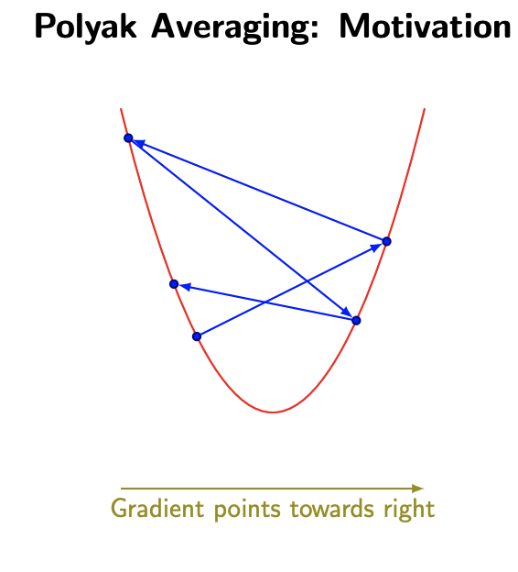
Classification
The algorithm: Momentum DQN
Polyak Averaging (Exponential Moving Average): is a technique used to optimize parameters in certain mathematical algorithms. The idea is to take the average of recent parameter values and set the final parameter to that average. The purpose is to help algorithms converge to a better final solution.

Slide 12
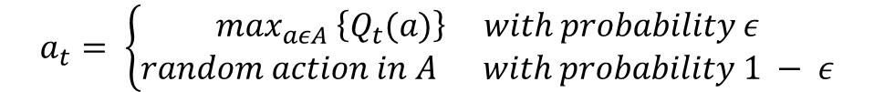
Classification
The algorithm: off-policy greedy strategy
$$a_{t}= \left\{\begin{aligned}\max_{aεA} \left\{Q_{t}(a)\right\} with probability ε \\ random action in A with probability 1 − ε\end{aligned}\right.$$
$$ε=1.0 →0.01, ε_decay=0.995$$

Slide 13
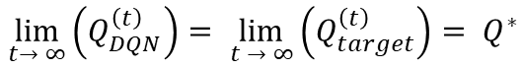
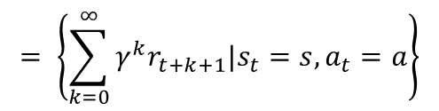
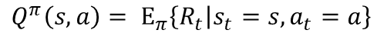
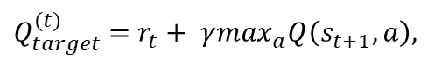
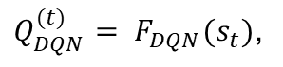
Classification
The algorithm: Q computation
Q definition
$$Q^{π}\left(s,a\right)= Ε_{π}\left\{R_{t} | s_{t}=s,a_{t}=a\right\}$$
$$= \left\{\sum_{k=0}^{∞}{γ^{k}r_{t+k+1}|s_{t}=s,a_{t}=a}\right\}$$
Target computation:
$Q_{target}^{(t)}$ = $r_{t}+ γ\max_{a}Q\left(s_{t+1},a\right),$
Prediction computation:
$Q_{DQN}^{(t)}= F_{DQN}(s_{t})$,
$$\lim_{t→ ∞}\left(Q_{DQN}^{\left(t\right)}\right)= \lim_{t → ∞}\left(Q_{target}^{\left(t\right)}\right)= Q^{∗}$$

Slide 14
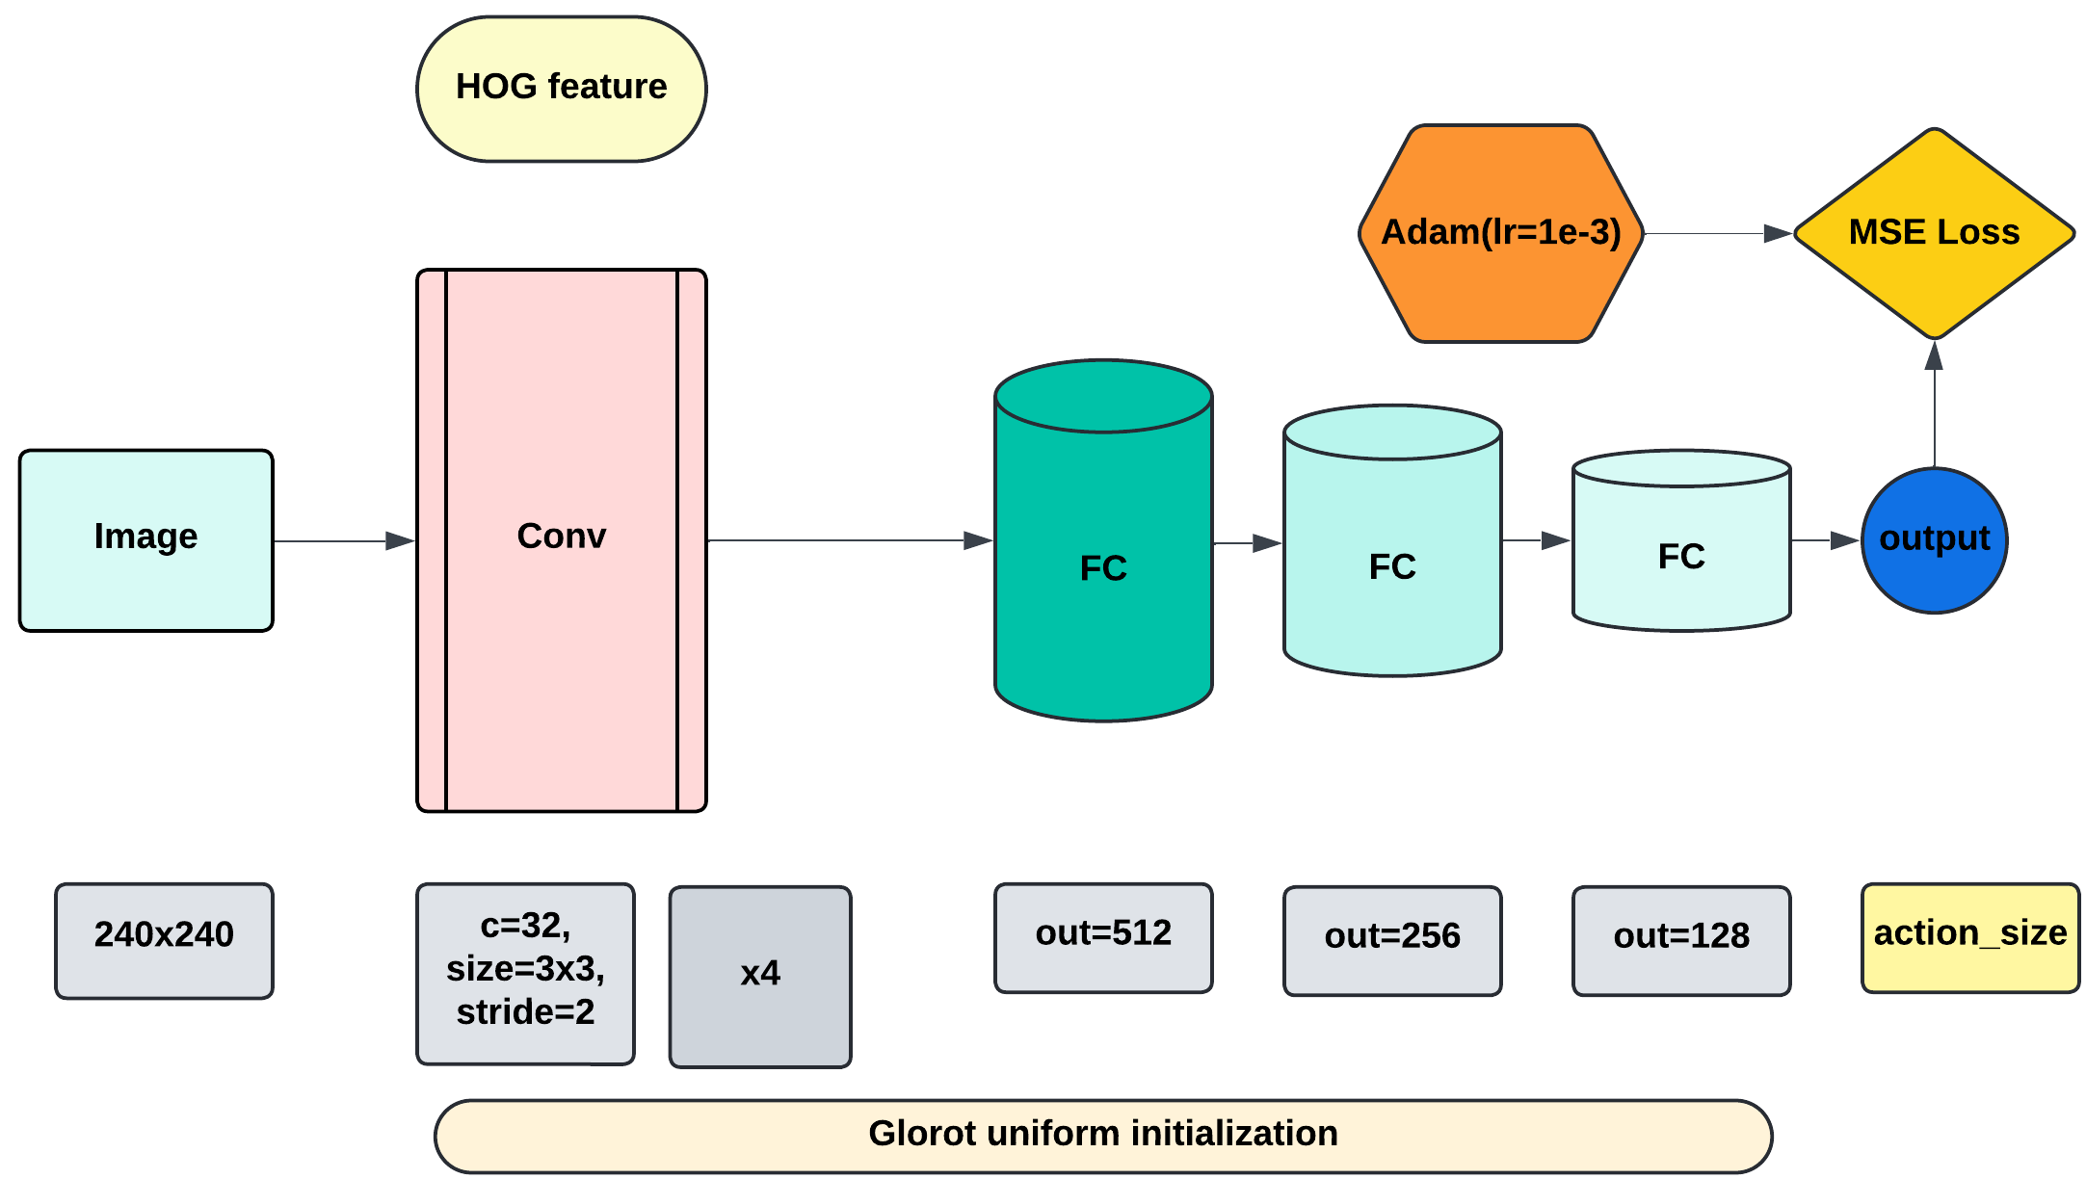
Classification
Deep Q Network Architecture

Slide 15
Classification
Network Update
After each K steps, both local and target network will be updated. The local network will be learned from experiences and the target network parameters will be updated with polyak averaging.
$$p_{target}= τ × p_{local}+\left(1−τ\right) × p_{target}$$

Slide 16
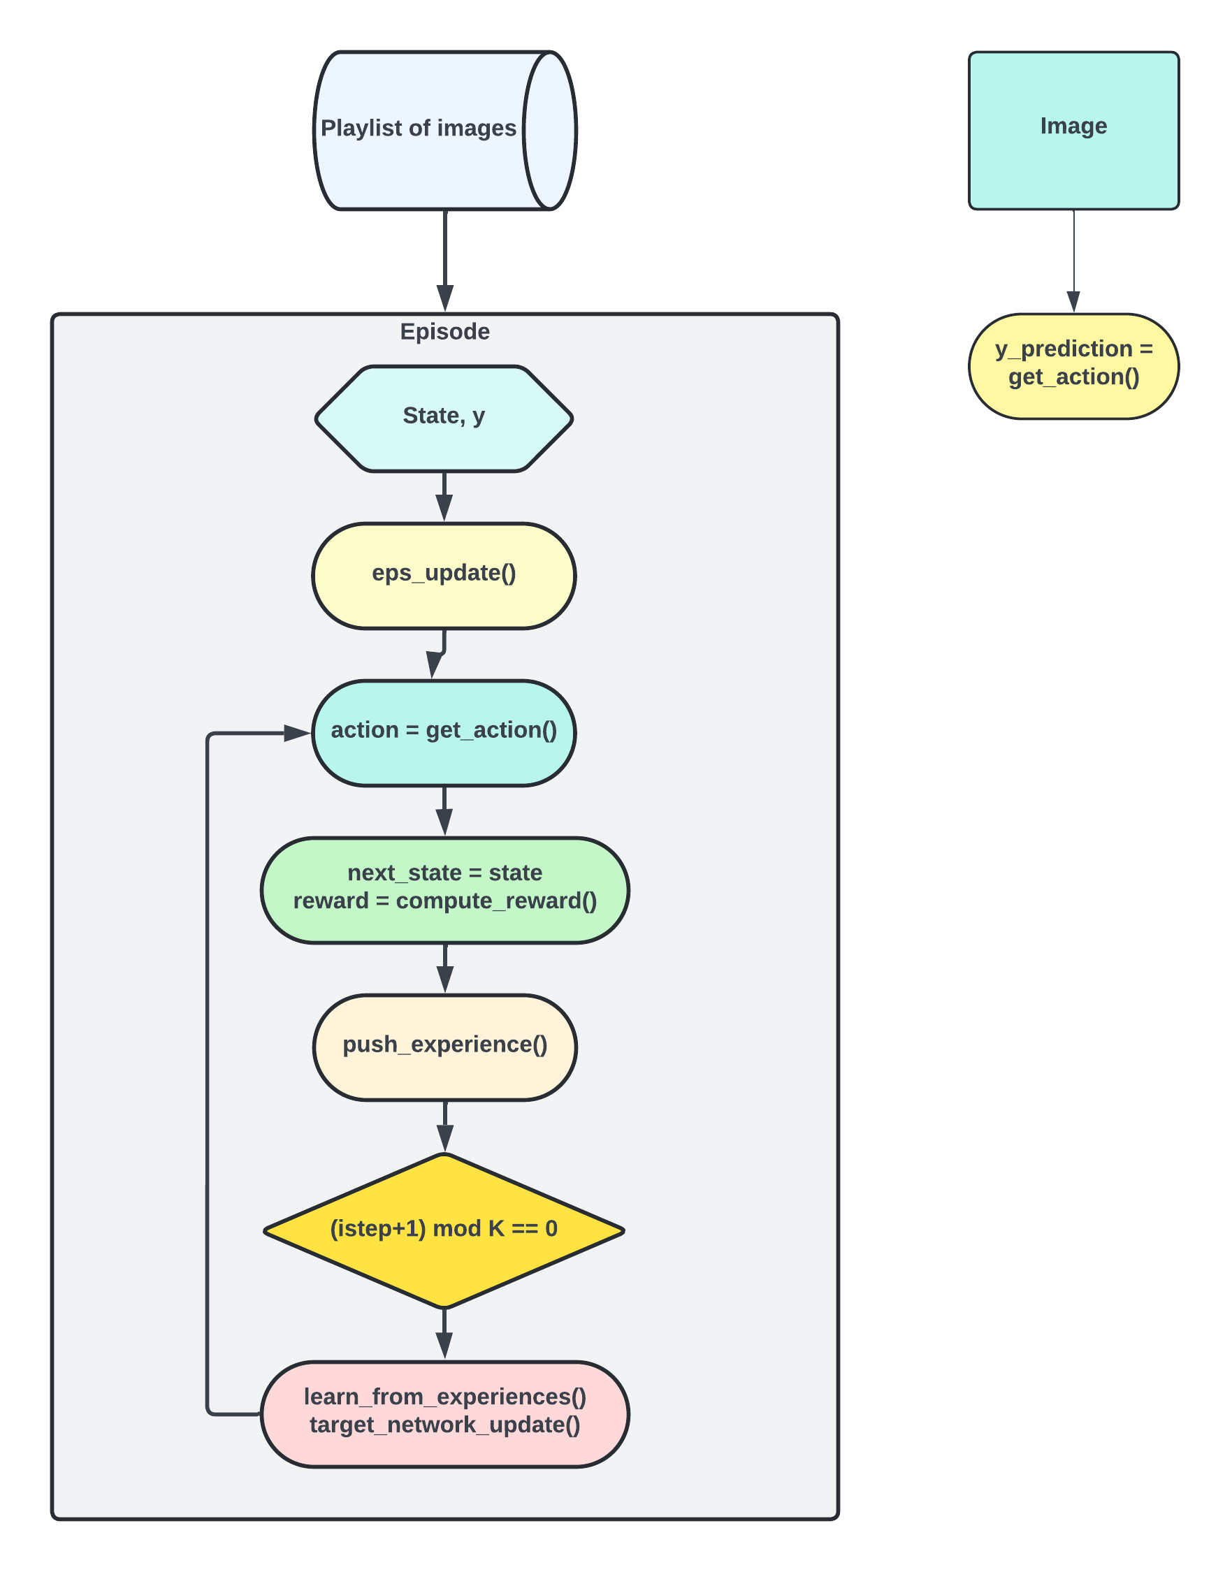
Classification
Flowchart

Slide 17
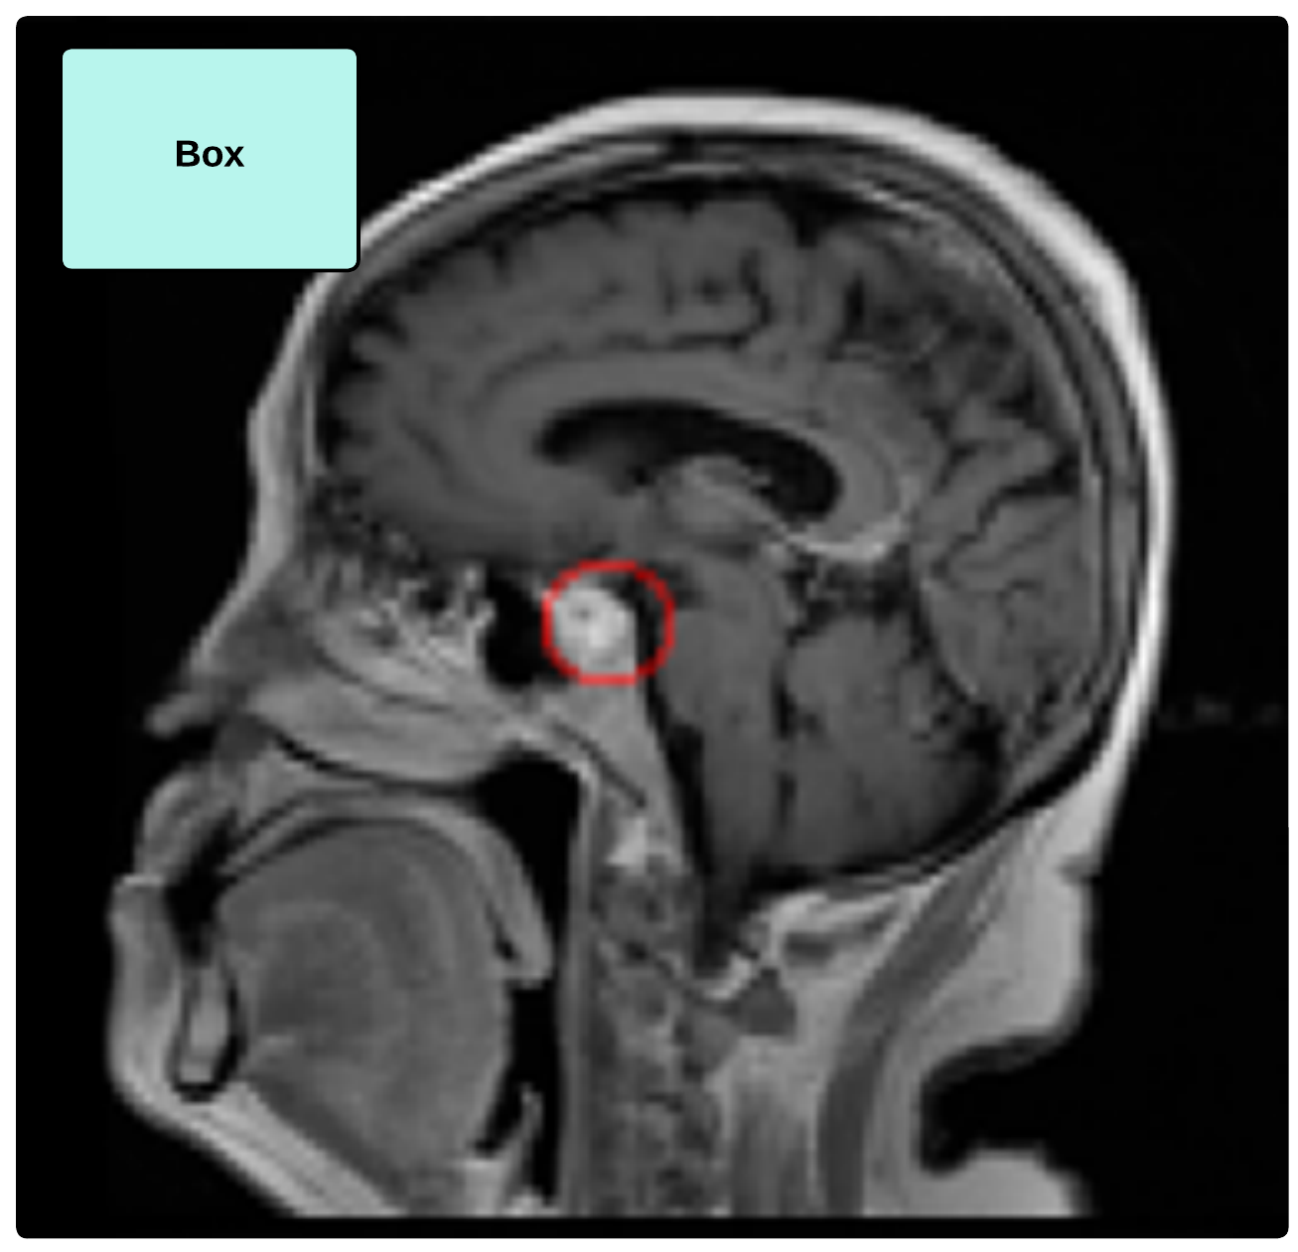
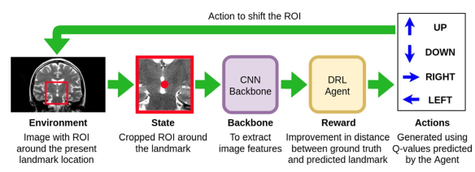
Localization
Traditional Approach

Slide 18
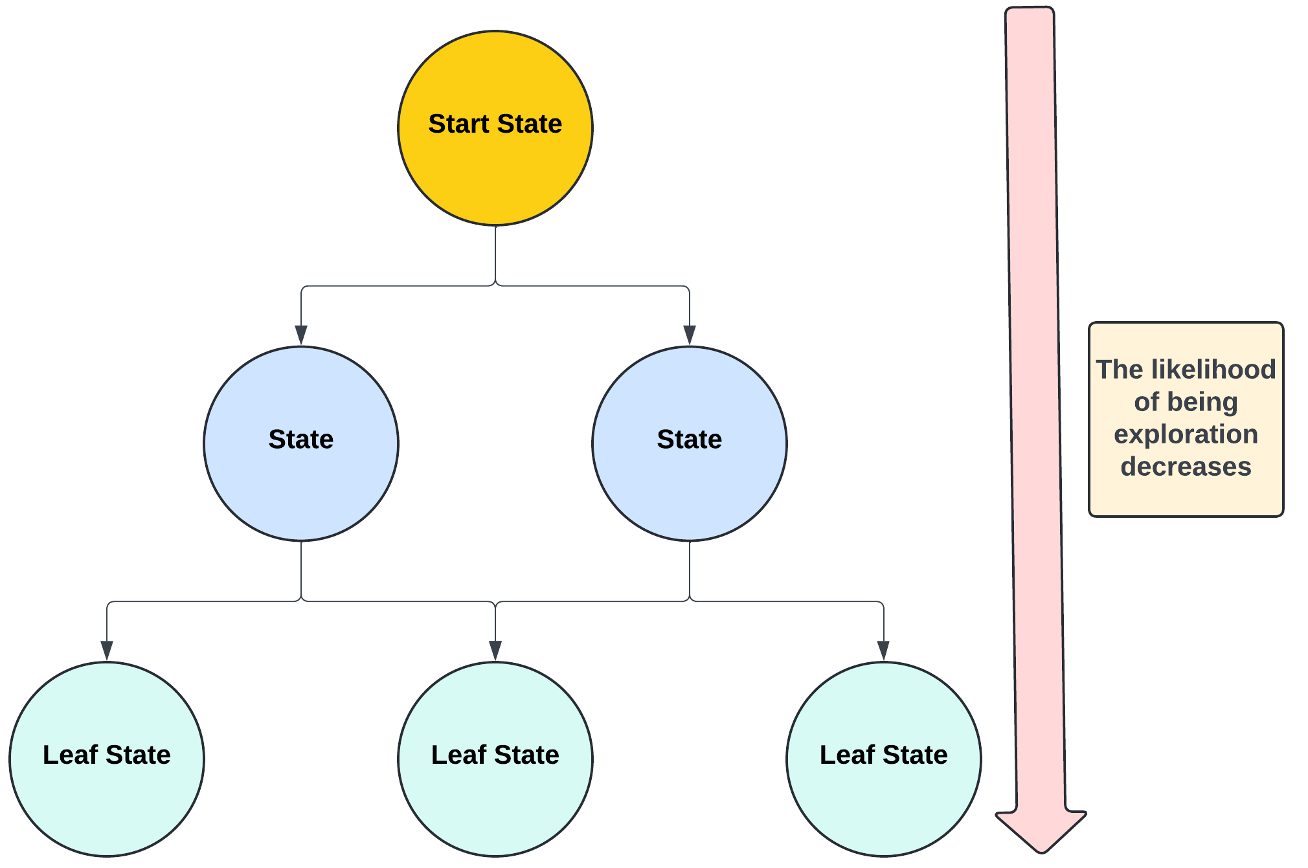
Localization
Traditional Limitation: DAG Environment

Slide 19
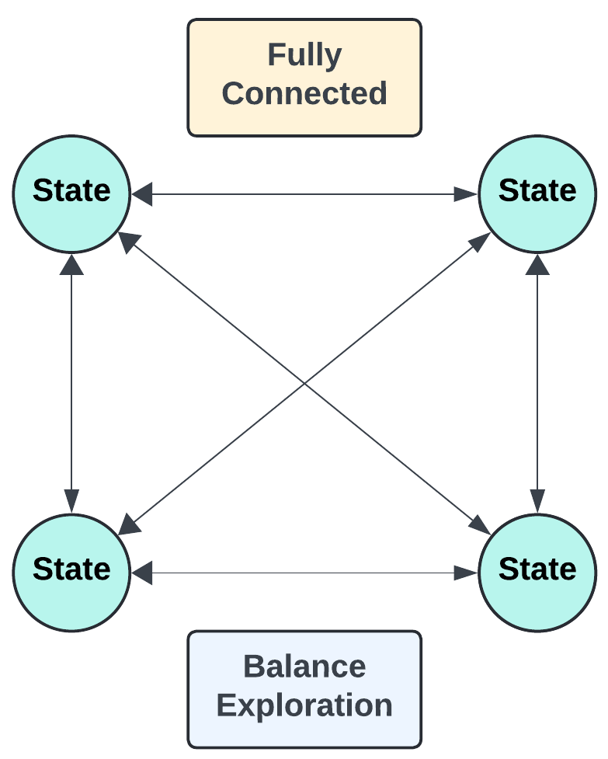
Localization
Finding: Complete Graph

Slide 20
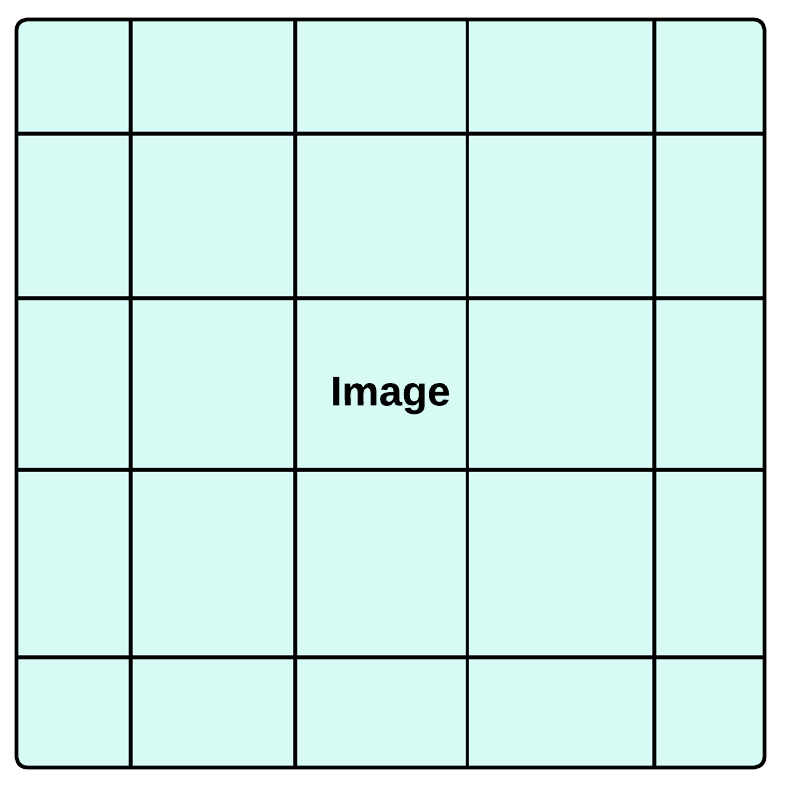

Localization
Finding: The breakthrough
Idea: Predicting the location of the tumor center instead of moving the bounding box to the tumor
Infinite action space: each action = a pixel of image (state)
From Localization to Regression
State

Slide 21
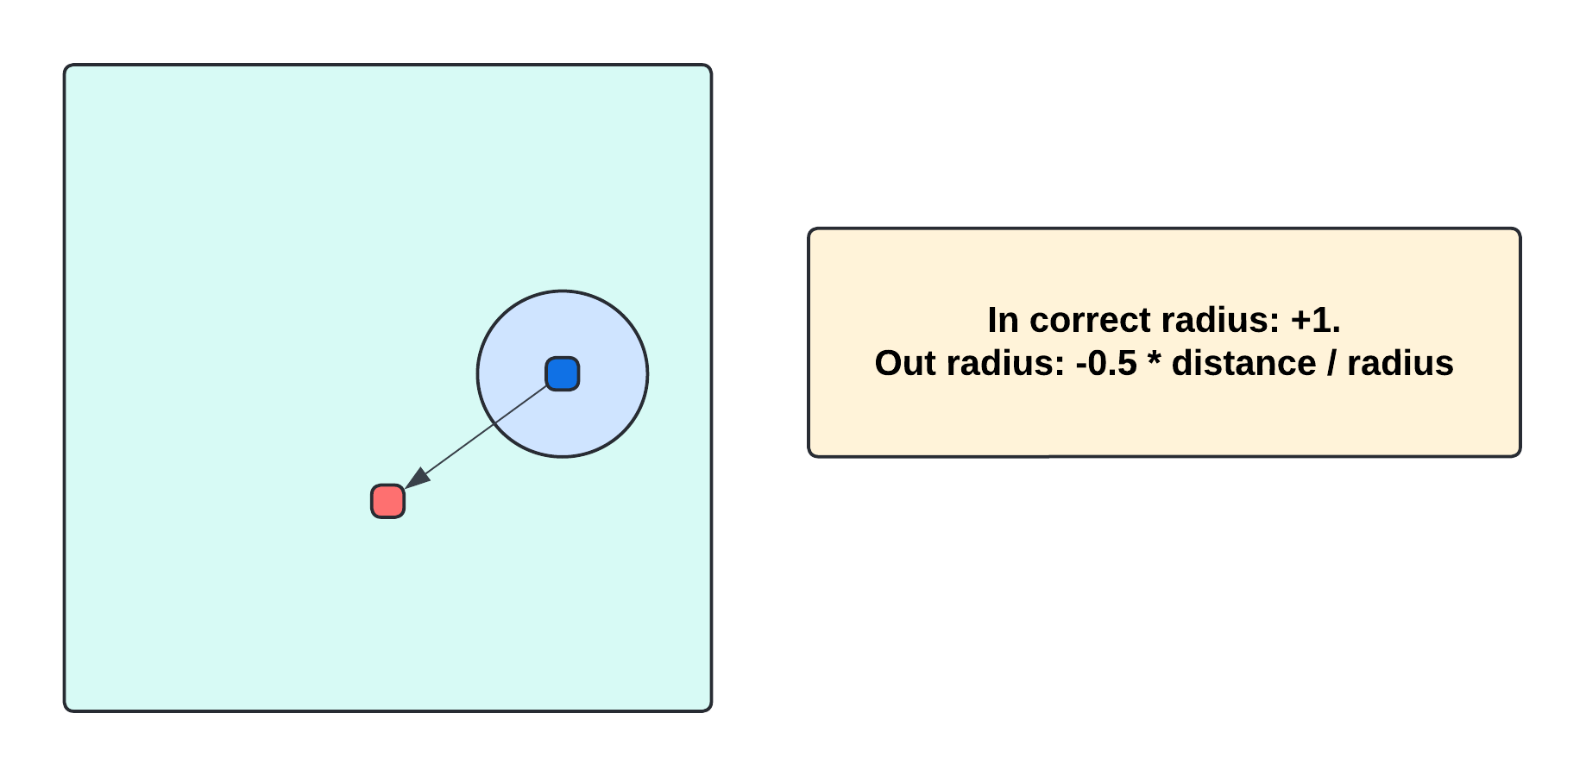
Localization
Finding: Reward Computation

Slide 22
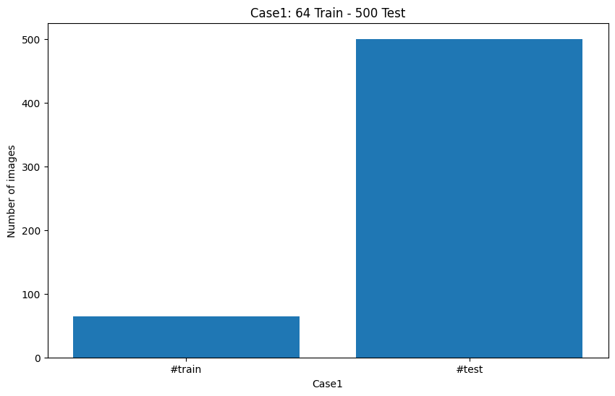
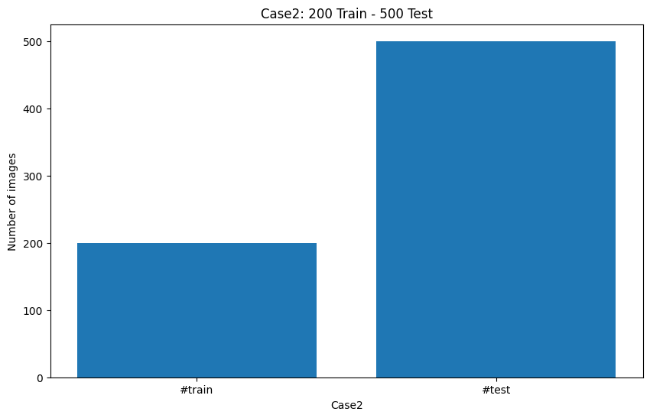
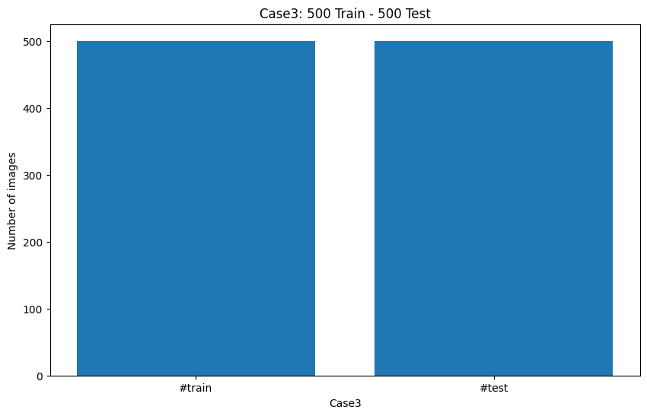
Comprehensive Experiment
Multi case:
classification

Slide 23
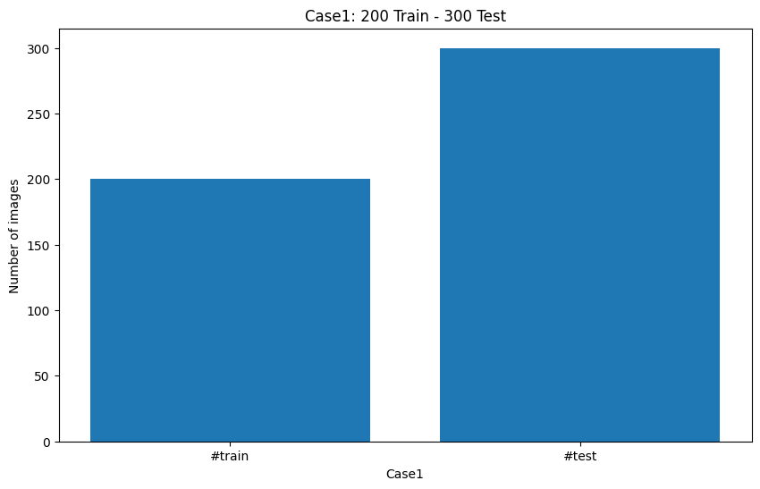
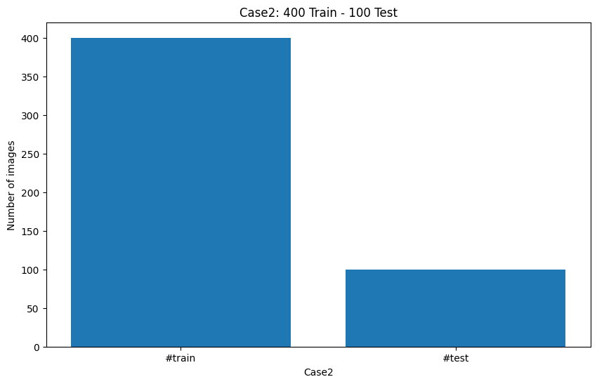
Comprehensive Experiment
Multi case:
localization

Slide 24
Comprehensive Experiment
Multi baseline
Machine Learning: SVC, KNN
Deep Learning: VGG16
Reinforcement Learning: Deep Q Network and Momentum DQN

Slide 25
Experiment Result (1)
ML and DL
 | Metric | KNN | SVC | VGG16
64-500 | Accuracy | 0.8600 | 0.8800 | 0.6580
 | F1-score | 0.8600 | 0.8800 | 0.6557
 | Recall | 0.8600 | 0.8800 | 0.6580
200-500 | Accuracy | 0.8700 | 0.9000 | 0.9120
 | F1-score | 0.8700 | 0.9000 | 0.9119
 | Recall | 0.8700 | 0.9000 | 0.9120
500-500 | Accuracy | 0.9300 | 0.9300 | 0.9440
 | F1-score | 0.9300 | 0.9300 | 0.9440
 | Recall | 0.9300 | 0.9300 | 0.9440

Slide 26
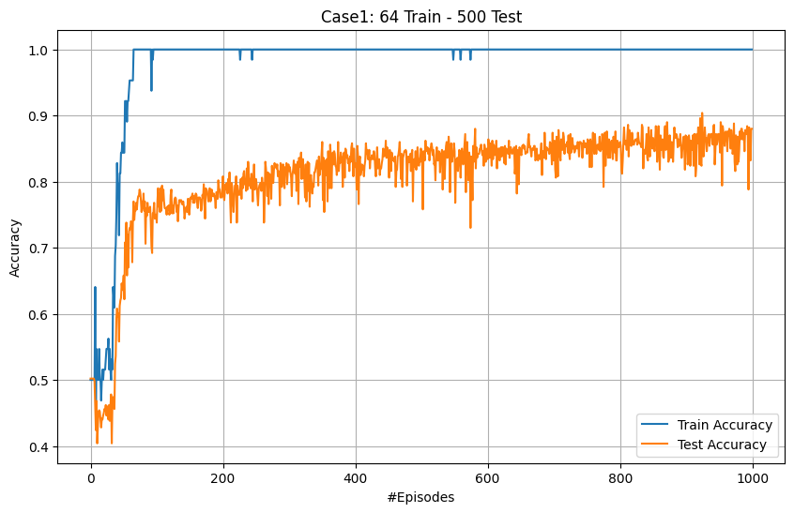
Experiment Result (2)
DQN

Slide 27
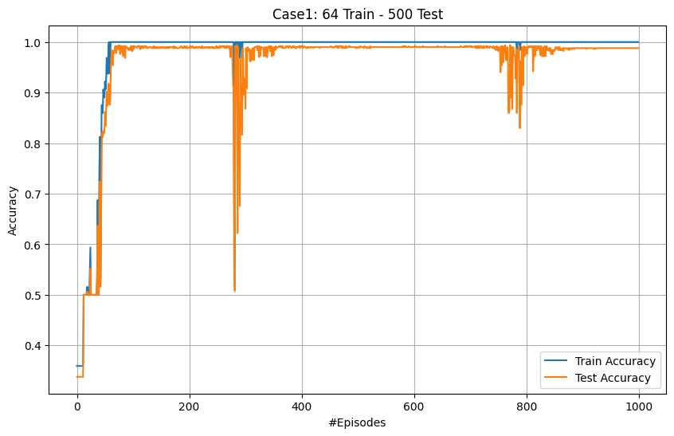
Experiment Result (2)
Momentum DQN

Slide 28
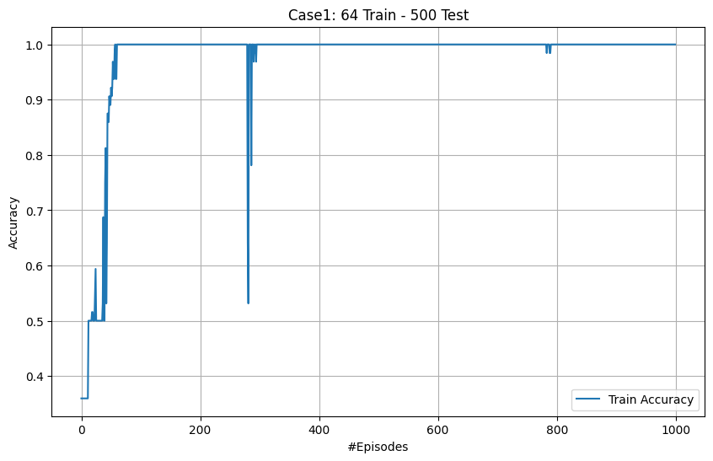
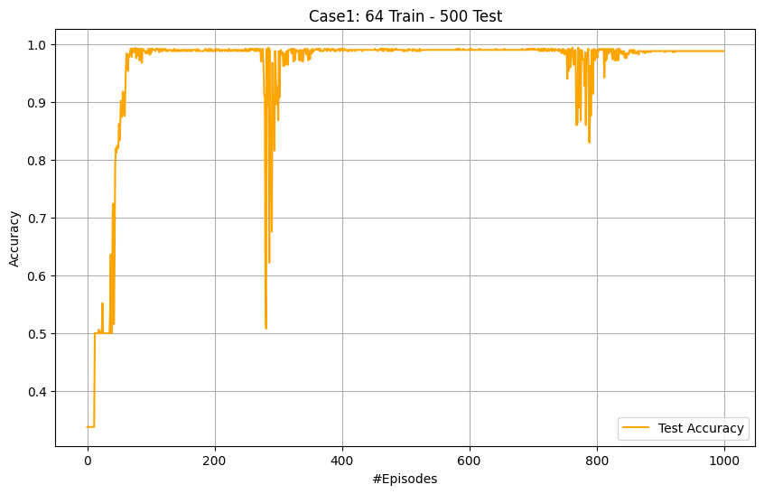
Experiment Result (2)
Momentum DQN

Slide 29
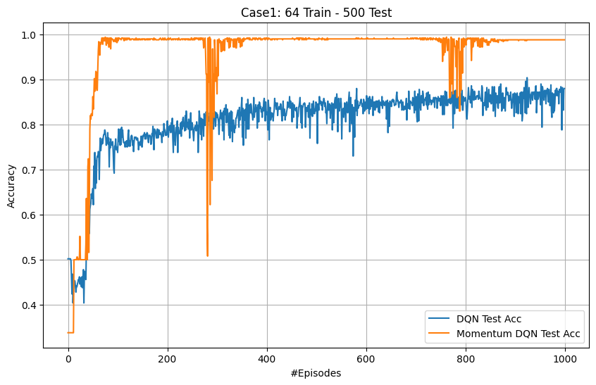
Experiment Result (2)
DQN vs. Momentum DQN

Slide 30
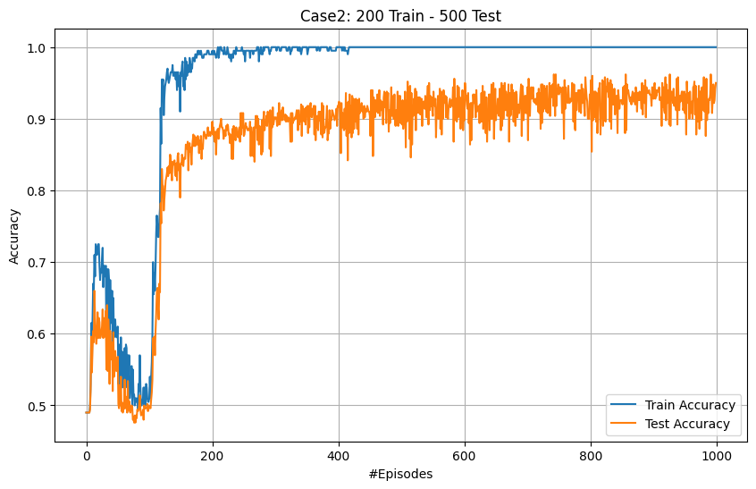
Experiment Result (3)
DQN

Slide 31
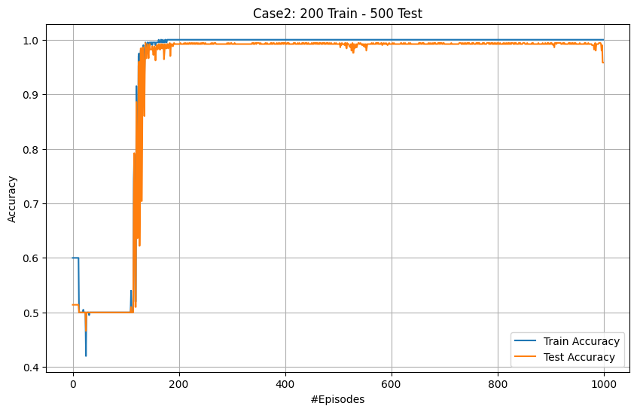
Experiment Result (3)
Momentum DQN

Slide 32
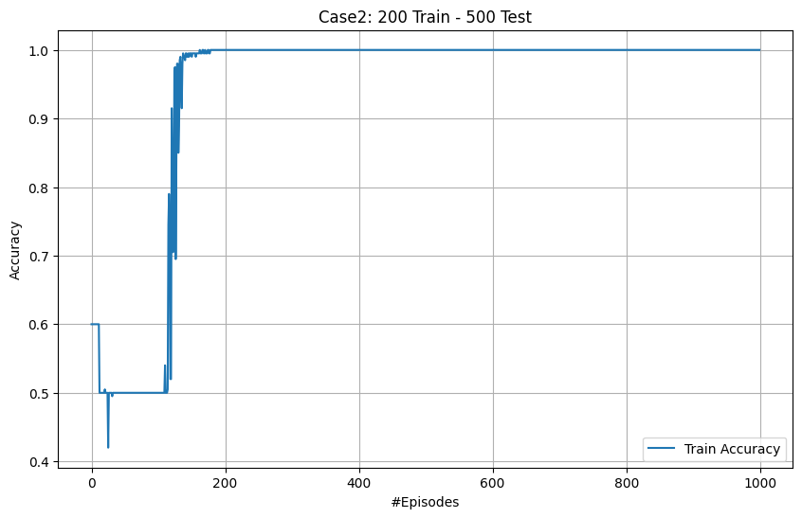
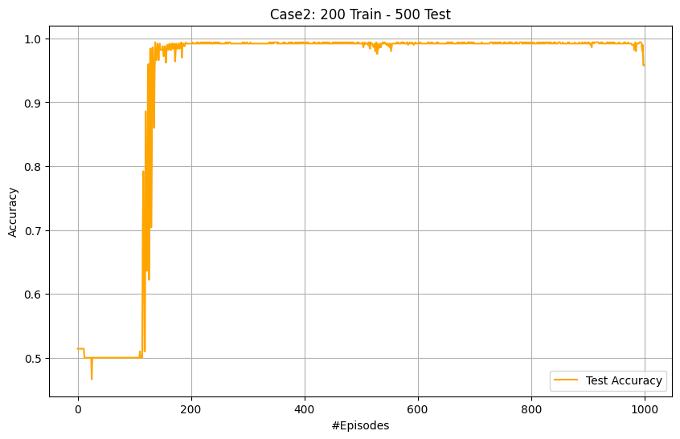
Experiment Result (3)
Momentum DQN

Slide 33
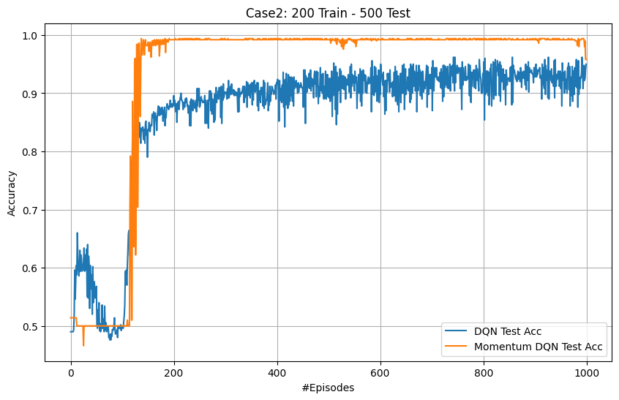
Experiment Result (3)
DQN vs. Momentum DQN

Slide 34
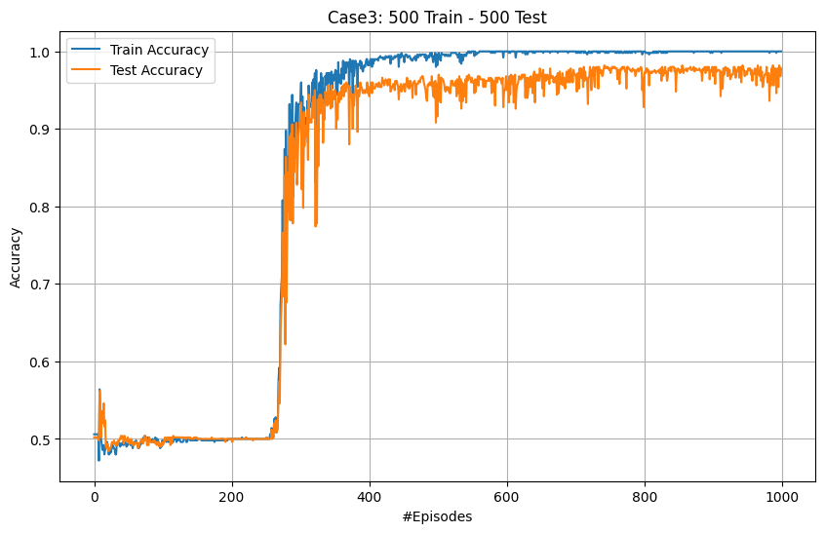
Experiment Result (4)
DQN

Slide 35
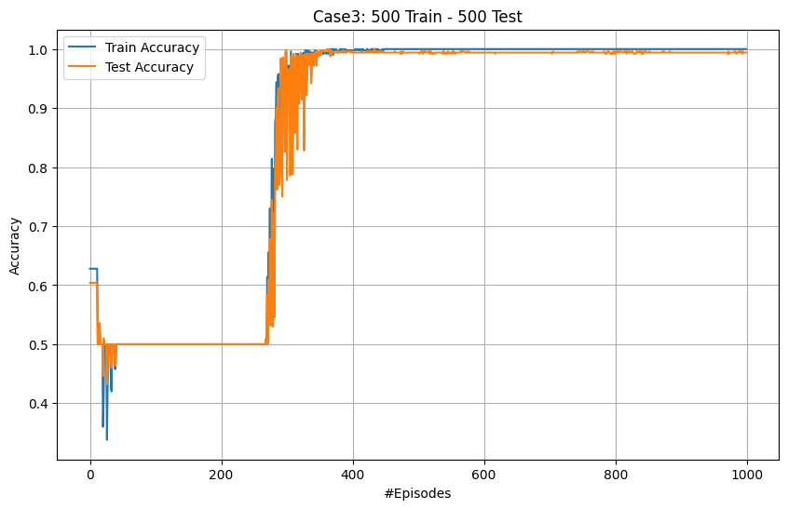
Experiment Result (4)
Momentum DQN

Slide 36
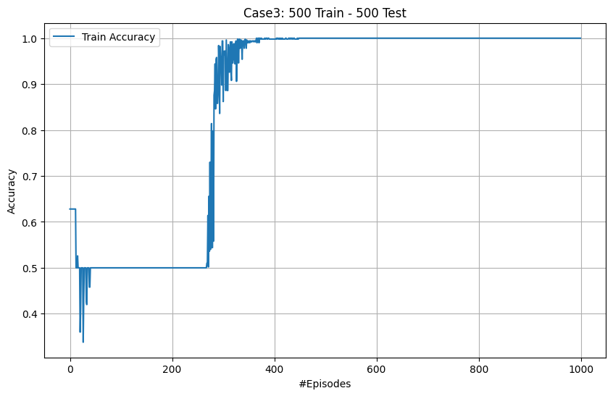
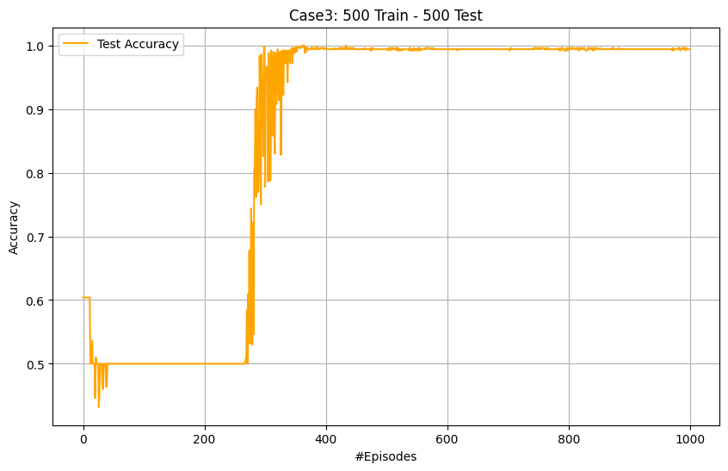
Experiment Result (4)
Momentum DQN

Slide 37
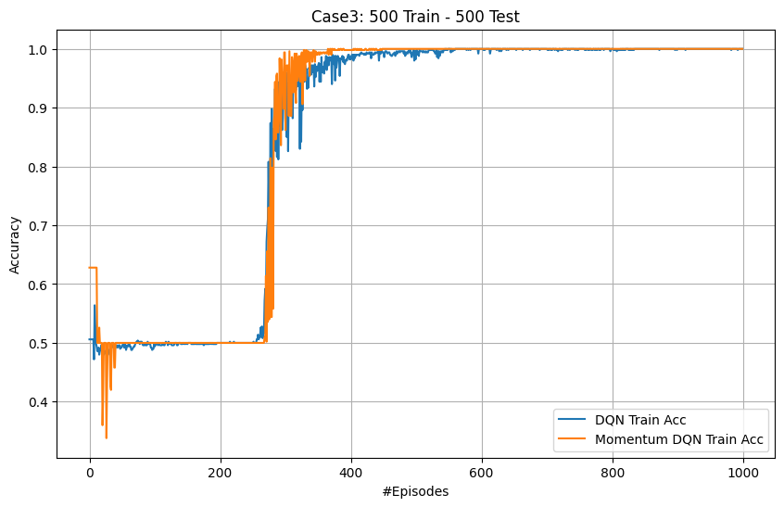
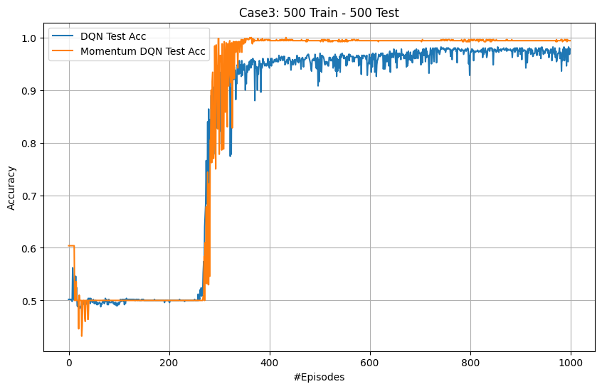
Experiment Result (4)
DQN vs. Momentum DQN

Slide 38
Result Experiment (5)
Momentum DQN Test Accuracy

Slide 39
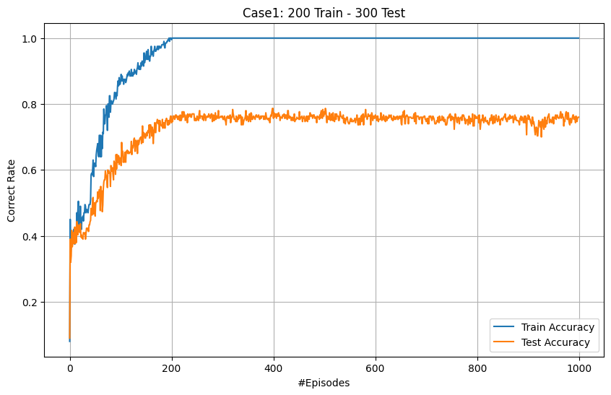
Experiment Result (6)
Localization: Momentum DQN

Slide 40
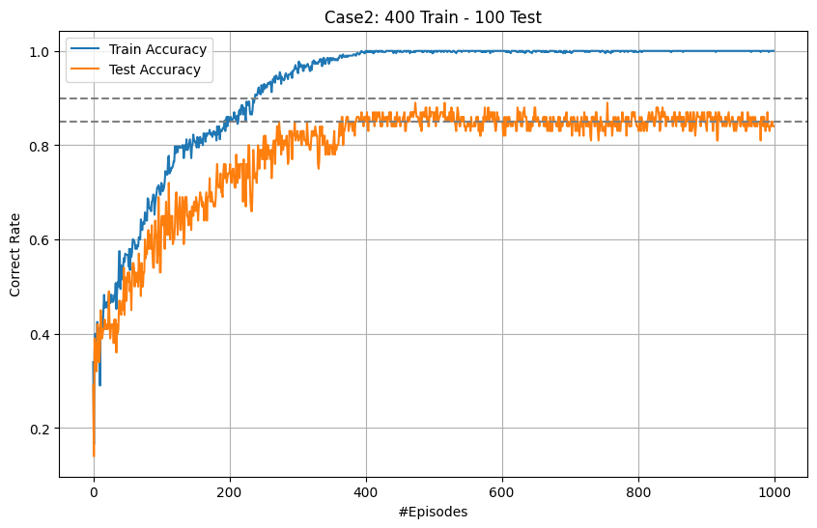
Experiment Result (6)
Localization: Momentum DQN

Slide 41
Experiment Result (6)
Localization: Momentum DQN

Slide 42
Experiment Result (7)
Comprehensive result
 | Metric | KNN | SVC | VGG16 | DQN | Momentum
64-500 | Accuracy | 0.8600 | 0.8800 | 0.6580 | 0.9040 | 0.9880
 | F1-score | 0.8600 | 0.8800 | 0.6557 | 0.9039 | 0.9880
 | Recall | 0.8600 | 0.8800 | 0.6580 | 0.9040 | 0.9880
200-500 | Accuracy | 0.8700 | 0.9000 | 0.9120 | 0.9620 | 0.9580
 | F1-score | 0.8700 | 0.9000 | 0.9119 | 0.9620 | 0.9579
 | Recall | 0.8700 | 0.9000 | 0.9120 | 0.9620 | 0.9580
500-500 | Accuracy | 0.9300 | 0.9300 | 0.9440 | 0.9820 | 0.9940
 | F1-score | 0.9300 | 0.9300 | 0.9440 | 0.9820 | 0.9940
 | Recall | 0.9300 | 0.9300 | 0.9440 | 0.9820 | 0.9940

Slide 43
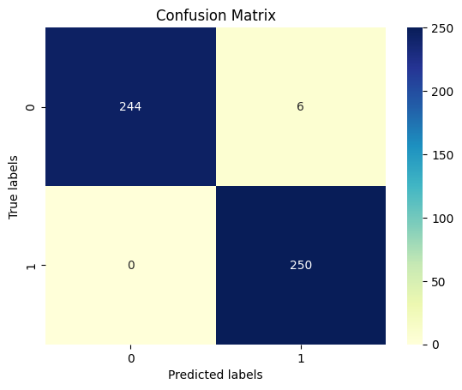
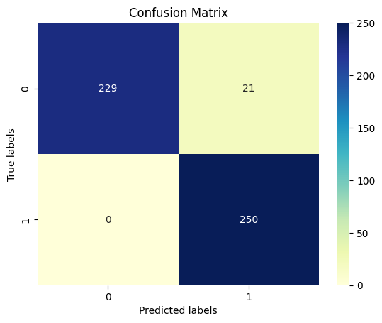
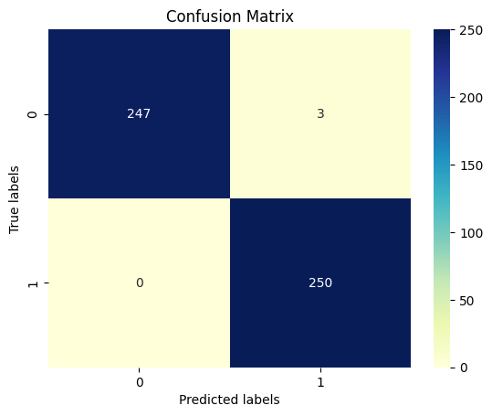
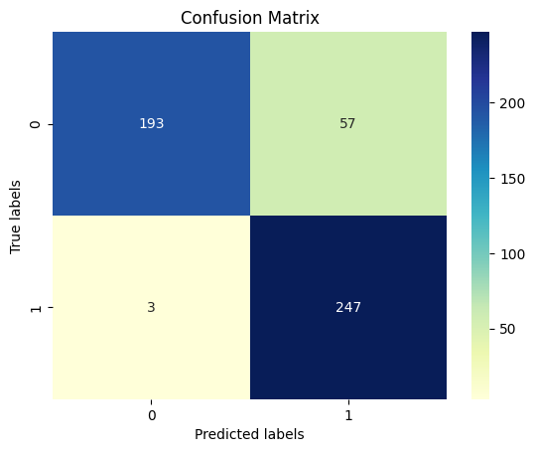


Experiment Result (8)
Momentum DQN Confusion Matrix
DQN Confusion Matrix

Slide 44
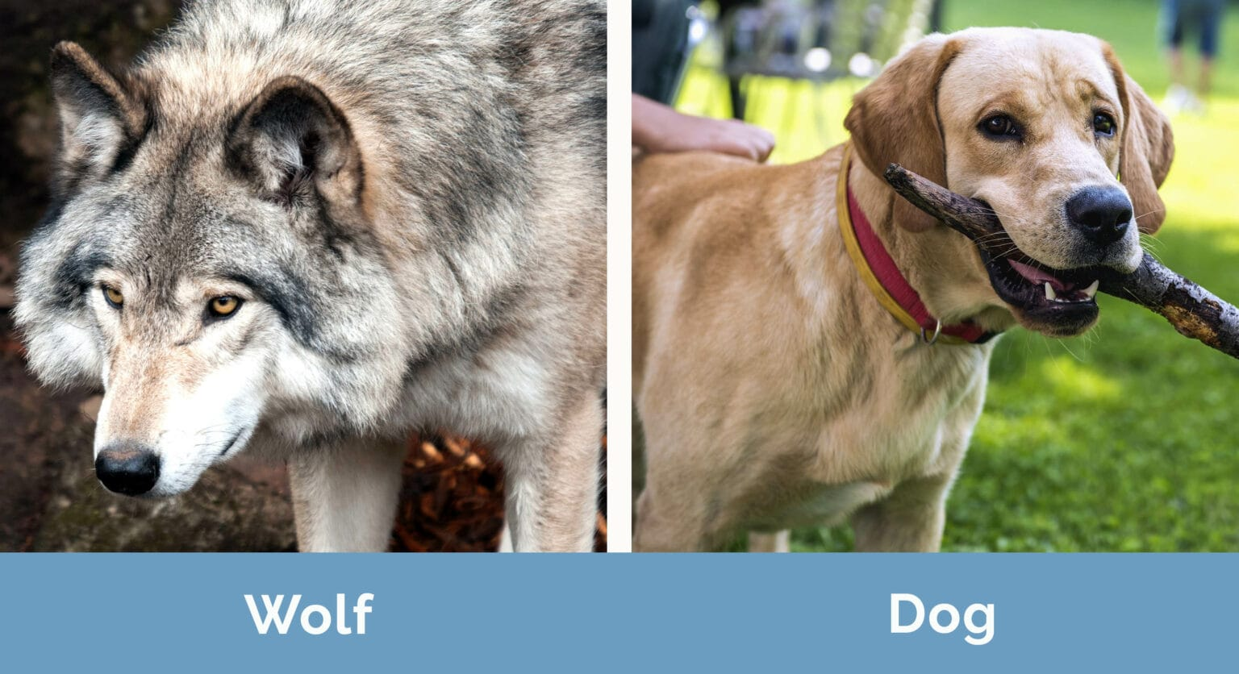
Explanation
How RL learn like human?
How CNNs learn?

Slide 45
Research Finding
We found the effectiveness of Reinforcement Learning in solving data scarcity and give an explanation for that effectiveness.
We also introduce the combination of DQN with Polyak Averaging Update which can improve model stability and learning (exploitation and exploration) performance.
Conclusion
Localization can face many limitations with a grid environment, we also propose a novel approach and reveal some new directions for Reinforcement Learning in the future.
In reality, having a variety of solutions to meet the diverse constraints of the problem is a crucial. Diverse solutions help us trade off, combine or improve solutions.
Amid Reinforcement Learning is not a silver bullet and may face limitations when operating in isolation. Combining it with other simple techniques is a way to unleash its full potential.
Notes:
However, spatial relationship, different intensity distribution features seem to be more essential.

Slide 46
Recommendation
New Insight Finding
Yolo version Reinforcement Learning?
How to coordinate multi agents to perform multi tasks? – Auto Encoder – Fusion Model

Slide 47
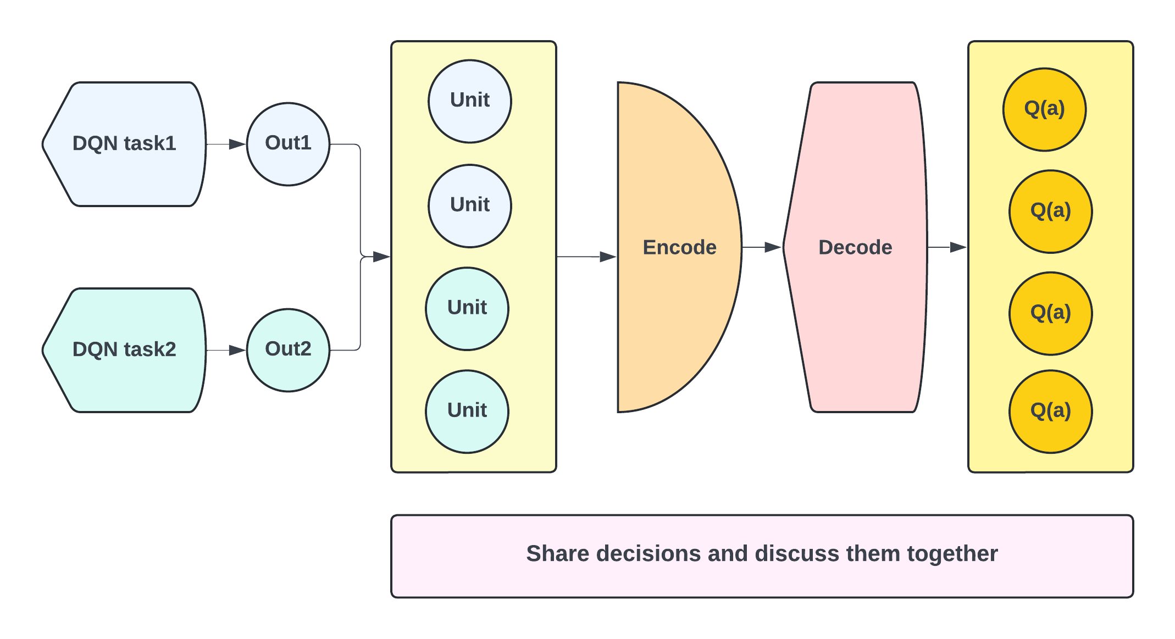
Recommendation
Auto Encoder – Novel Fusion Model

Slide 48
Thank you
THANKS

Slide 49
References
Doctor:
Hoang Ngoc Huynh
Quang Tri General Hospital
Phone: 091 5711133
Mertrics:
On evaluation metrics for medical applications of artificial intelligence | Scientific Reports (nature.com) - 2022 - 163 citations
Applied Sciences | Free Full-Text | Classification of Brain Tumors from MRI Images Using a Convolutional Neural Network (mdpi.com) - 2020 - 302 citations
TOWARDS A GUIDELINE FOR EVALUATION METRICS IN MEDICAL IMAGE SEGMENTATION - 2022 - 96 citations
Dataset:
Brain Tumor MRI Dataset (kaggle.com) - 2022

Slide 50
References
Method:
Applied Sciences | Free Full-Text | Classification of Brain Tumors from MRI Images Using a Convolutional Neural Network (mdpi.com) - 2020 - 302 citations – Figshare
Brain tumor MRI images identification and classification based on the recurrent convolutional neural network - ScienceDirect - 2022 - 62 citations – Sartaj
BRAIN TUMOR MRI IMAGE CLASSIFICATION WITH FEATURE SELECTION AND EXTRACTION USING LINEAR DISCRIMINANT ANALYSIS - 2012 - 79 citations
Brain tumor detection and classification using machine learning: a comprehensive survey | Complex & Intelligent Systems (springer.com) - 2021 - 118 citations
Brain tumor classification for MR images using transfer learning and fine-tuning – ScienceDirect - 2019 - 491 citations - lock [not free] – Figshare
Medical images classification using deep learning: a survey | Multimedia Tools and Applications(springer.com) - 2023 - 1 cite - lock [not free]
Brain MRI Detection | Segmentation | ResUNet (kaggle.com) - ResUnet
Brain Tumor Classification from MRI Using Image Enhancement and Convolutional Neural Network Techniques - PMC (nih.gov) - 2023 - Same Dataset

Slide 51
Thank you
N-THANKS

Slide 52
Classification
The algorithm: Momentum DQN
Double DQN: was first proposed by Google Deep Mind in an article titled Deep Reinforcement Learning with Double Q-learning. It is a technique used in Deep Q-Networks (DQNs) to address the issue of overestimation bias.
Reduces overestimation bias, leading to more accurate learning.
Improve the stability and performance of DQN, especially with small datasets.

Slide 53






Visualization
pituitary/Tr-pi_0621.jpg

Slide 54



Limitation Finding
Pituitary
Glioma
Glioma
Predicted Label
Notes:
Very small, unclear shape, may be very similar to surrounding healthy brain tissue

